Slide 1
The diversity of plaques in London and identifying ‘bad actors’
Analyzing the diversity of the people commemorated on the open plaque database in London and identifying ‘bad actors’

Slide 2
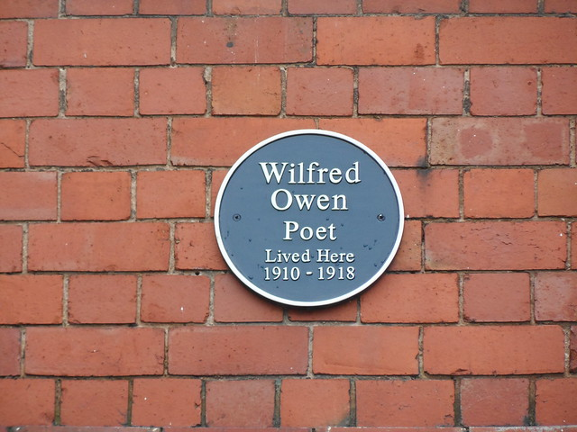
Contents
Why
Who + What
Where
When
How

Slide 3
Why
The recent interest in the ‘Black Liver Matter’ movement has led to the scrutiny of many public status and monuments as to whether the attributed person deserves to be kept up due to there links to the slave trade and racism.
Plaques are in the public domain and thus should also undergo the same scrutiny.
It is also of interest to see the diversity of those commemorated on the plaques to observe the extend of implicit and explicit bias’s.

Slide 4
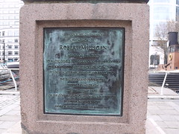
Who, what, where
This report will look at individuals commemorated by plaques found in the London on the http://openplaques.org/ database.
The aim is to investigate the diversity of those commemorated on plaques in London and to identify those who have links to the slave trade.

Slide 5
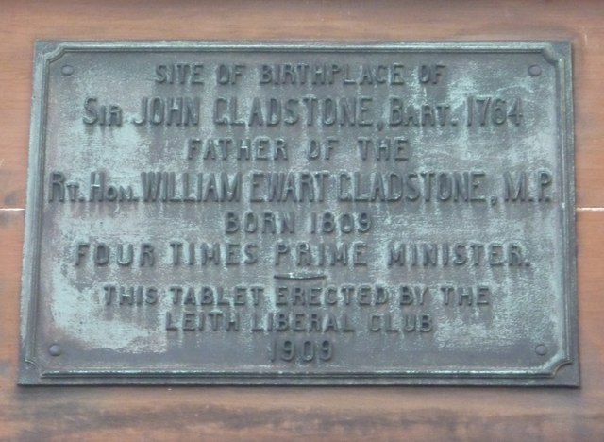
When
This report is a side project of the openplaques open source repository.
Work on the report was done from: 11-06-2020 to 09-07-2020

Slide 6
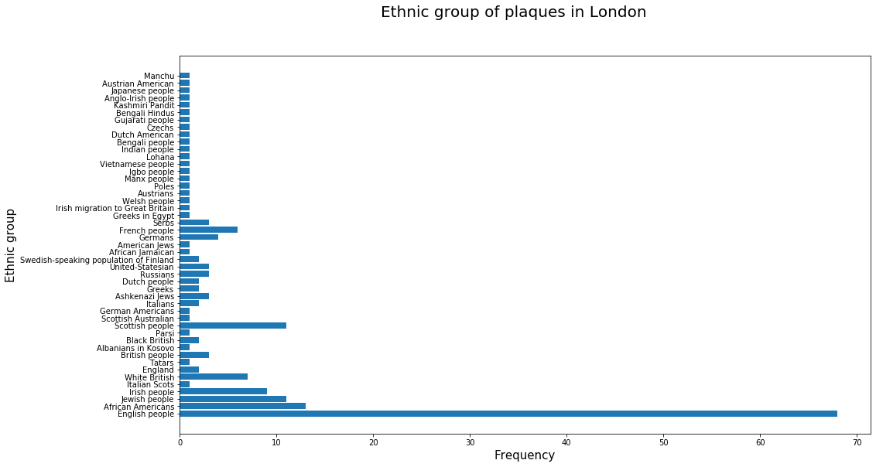
How – diversity of plaques In London
To retrieve the ethnicity of whose on the plaques, I used a qwikidata api to fetch data from the wikidata database for individual on the plaques.
Not all entries had ethnicity fields as a property so the chart could be unreliable if there are correlations to the entry being there e.g. if the entry is more likely to be there if the individual is say White British.
The chart shows the overwhelming majority of those commemorated are British/English.

Slide 7
How – individuals with links to the slave trade
To identify bad actors I made a scoring system taking into account the following:
The presence of certain words on their Wikipedia pages
Whether they appear on the slave owner list on Wikipedia or Wikidata
Whether they appear on the abolitionist list on Wikipedia
Ethnicity
Birth period
The above criteria gave both positive and negative scores (higher the score the worse).
Words such as ‘poet’/’author’/’composer’ appearing on the Wikipedia pages reduced the score, assuming the correlation that most poets/writers/… were against slavery.

Slide 8
How – individuals with links to the slave trade
The results from this test finding those with the highest chance to links with slavery follow:
Robert Milligan William Ewart Gladstone Admiral Sir Edward Codrington RN GCB FRS Simón Bolívar John Gladstone FRSE Quintin Hogg George Whitefield Richard Cobden Dr James Wilson William Murray, 1st Earl of Mansfield John Graves Simcoe Thomas Drayton Sir Lt Gen Thomas Picton GCB Sir Francis Drake John Hancock
Key:
Slave trader/owned slaves
That is not to say that the other names certainly deserve a place but they are not slave traders/owners from the Wikipedia search I conducted.

Slide 9
Conclusion
There is not a large diversity of those commemorated by plaques in London
The bad actor scoring system does effectively filter down the number of possible candidates, reducing the time needed for a human to check those commemorated.
The scoring system still needs a human to validate the choices – often the links are more complicated e.g. money/slaves inherited from family which the simply model cannot differentiate.

